Slide 1
Enhancing Clinical Effectiveness
And
Decreasing Administrative Burden
Elizabeth Sullivan – Group Product Manager for CureMD
Notes:
Introduction and Kickoff:
Introduction:
Introduce self – Hi, I’m Elizabeth. I am the Group PM for the Clinical side for CureMD. I’ve been here for the past 2 years.
I was a Nurse in the hospital for 15 years in Critical Care.
I pivoted in my career to healthcare software about 15 years ago
Worked in 1st Nursing Informatics team from original healthcare system that I was a bedside nurse at
Change is never easy – I understand your frustration and pain
Especially in healthcare - Sick patients, packed waiting rooms, stressed out staff
So, I wanted to Thank you for taking the time out of your busy schedule to come here and give us the opportunity to talk to you today on what we are planning to do to make your future days less stressful so you can take care of your pts the best way possible.
Kickoff to session:
EHRs weren’t built foremost for physicians and clinical effectiveness.
They were built against regulation and to optimize revenue.
Now, we’re laser focused on helping all of you save time and effort.
We have heard from our providers and their staff.
They repeatedly express how much work they have to do to deliver care.
We know there are many steps and inefficiencies that slow down your day and reduce the time available for care delivery.
In this session, we’d like to discuss how we are going to make the system better for you.
We want to help reduce all those little burdensome tasks each day.
We have focused our efforts on a few areas within CureMD that will make a big impact on your day.
We are looking to you all to be our partner. We want your feedback.
Some of the screen shots you will be seeing are prototypes. Prototypes are just a direction we have chosen. We can pivot at anytime based on your valuable feedback.

Slide 2
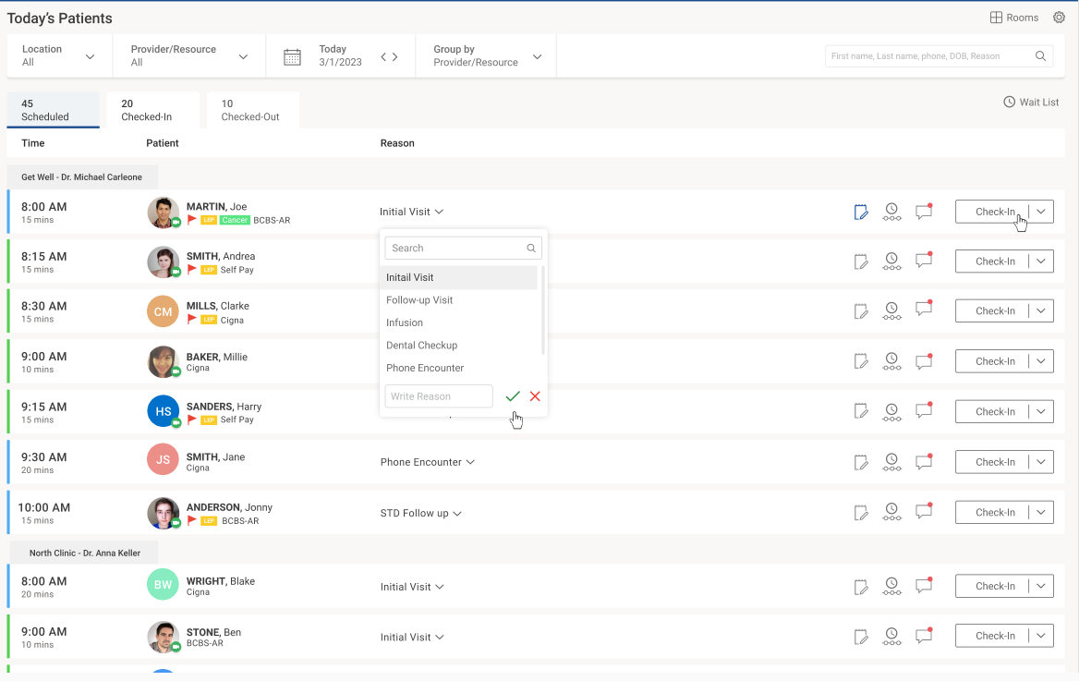
Notes:
One of the biggest areas where we are focused on in CureMD is revamping the Today’s Patients screens.
We want to make it as easy as possible to get the patient in the door, get them settled and ready to see the provider.
For the Front Desk staff, we recognize that some of our modules are really clicky and takes extra effort to get things done.
Example of this is the check in process with our current Scheduler. Find patient on the grid>click the patient>menu comes up>click Check-In>start process begins
This has been a big client request - the ability to see Scheduled Patients in Today’s Patients
Now – you will have the **Ability to access and check in Scheduled patients from the Today’s Patients screen.
Much simpler workflow than what you have on the scheduler.
Updates automatically- so 5 people can work on the scheduler at the same time and not step on anyone’s toes.
Other features on this screen: Ability to toggle between Scheduled Patients, Checked-In Patients and Checked Out Patients with a counter for the number of pts in each category.
You can filter on by the Provider’s Location or Group the patients by the Provider or Resource.
You can easily toggle between Dates by selecting the forward or backwards arrow or find a specific date on the Calendar.
You can easily search for a patient – first name, last name, DOB, phone # or Reason
We’ve also added Tags under the Patient’s Name to provide you with relevant clinical information like the red flags denoting confidential patient and LEP – limited English proficiency.
Complete the check-in process in one smooth workflow.
Three icons to the left of Check-In button (tool tip will appear when you hover over it):
Appointment Notes where you can add in notes.
Timeline – where you can view timeline logs of the appt
Messages – where you’re able to communicate with other practice users.
Note: When you click the icon, it will open the respective component in the right panel.
Dropdown next to Check-In: Allows the user to change the patient’s status. You can mark the patient as a No-Show or Cancel the Appt.

Slide 3
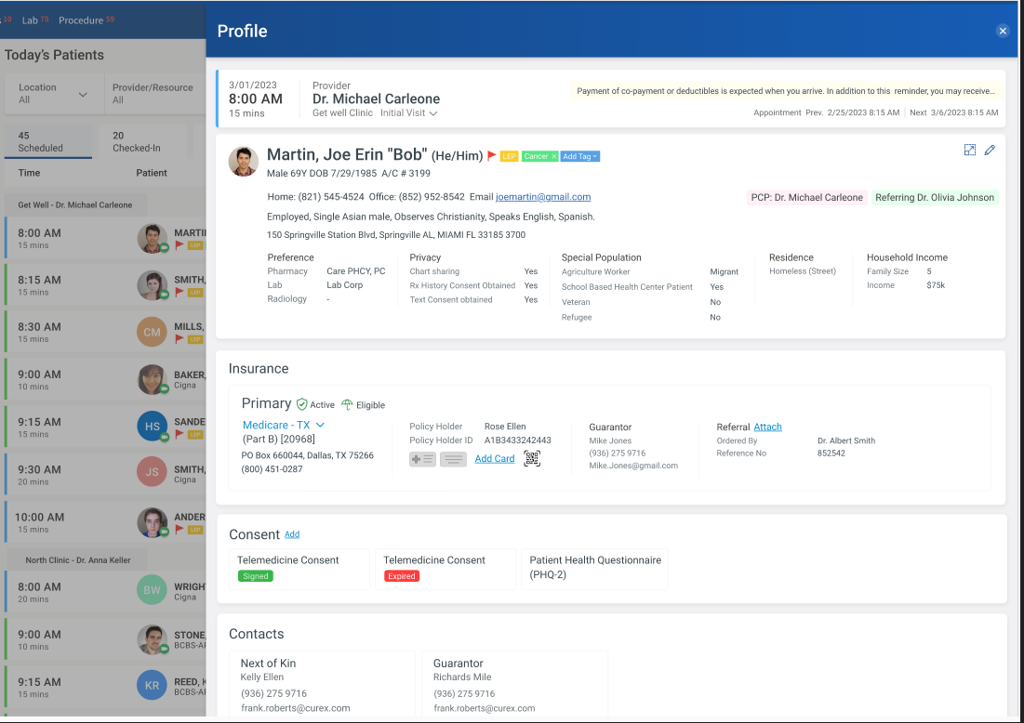
Notes:
When you click on the patient’s name on the Today’s Patients dashboard, the Patient Profile becomes available.
You can verify the patient information you have on file. Make any edits as needed to the patient’s insurance, address and phone number.
You can add new insurance cards, attach a referral or add patient consents.

Slide 4
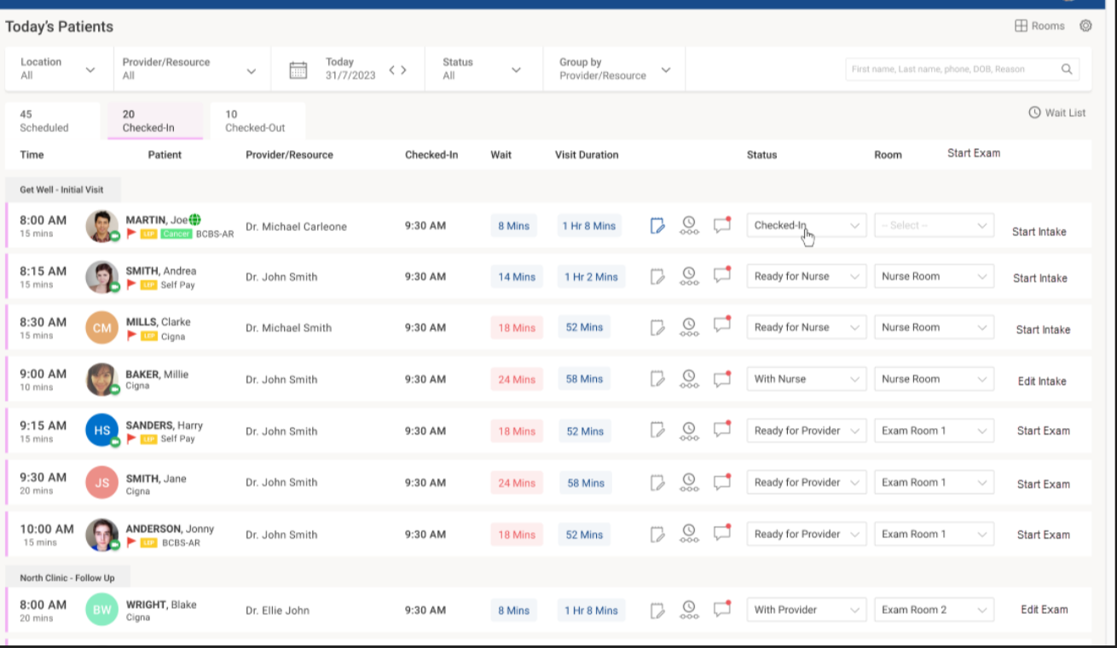
Notes:
Once the patient is checked in, the nurse can start the intake process and click “Start Intake” that launches to a new workflow where the nurse/MA can get vitals and fill out or review any intake forms for the patient.
Once the nurse has completed their Intake, they can change the status to “Ready for the Provider” and the provider can “Start Exam” by clicking on the Start Exam button and launch into their workflow.
The buttons on the far right hand side will launch the nurse or the provider out into their workflow – like Start Intake, Edit Intake, Start Exam, Edit Exam, etc. where when the user selects these buttons.
You’ll also notice on this screen that - there are various Statuses the user can toggle between based upon where the patient is in their journey: “Checked-In”, “Ready for Nurse”, With Nurse, Ready for Provider, With Provider.
You can also toggle between Rooms: Nurse room, Exam Room 1, 2, etc.
Key metrics on this screen include: When the Patient Checked-In, Wait Time, and Visit Duration are all seen on this screen.
Wait List icon on this screen In the event that a patient cancels or is a no-show. You can quickly access your wait list of patients and fill that canceled appointment immediately.

Slide 5
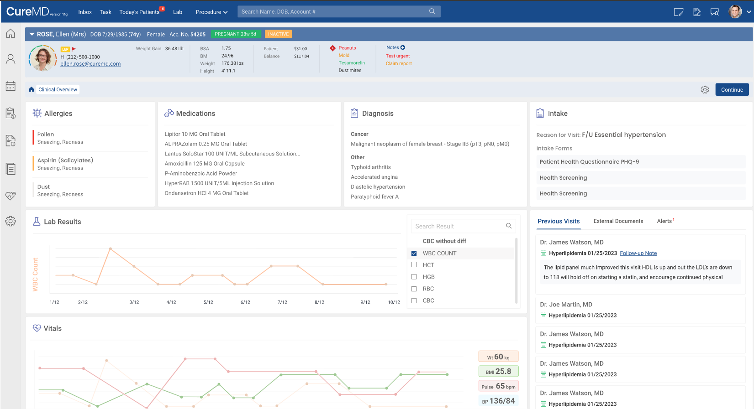
Notes:
The first screen the provider will see after they click Start Exam is our new Clinical Overview screen.
We have completely revamped our Clinical Overview screen- now it is very interactive and provides the provider with all the relevant clinical information on the patient before they are seen.
Such as: Allergies, Medications, Dx, Intake forms, Lab Results, recent Vitals, summary of previous visits, external documents if the patient went someone in-between seeing the provider like an urgent care, Alerts, etc.
You can now trend or graph the data points for the separate Clinical Component segments.
We would like to present the data in a unified single view where the user can plot different segments of the data against each other for the best use case scenarios.
For instance- you could plot your systolic/diastolic BP against your BP medication based on dosage/time used.
These graphs would be configurable - customizable

Slide 6
Notes:
Here’s a high level summary for those of you who were unable to attend yesterday’s breakout session on Commonwell and Care Quality- largest record sharing network in the US.
Currently we have access to individual documents flowing into CureMD and you can view and reconcile the meds, allergies and dx on these individual documents to the information we have in CureMD.
In the very near future though, you will have access to a summarize view of all of that information.
But, you need to sign up to participate in this network sharing of records.

Slide 7
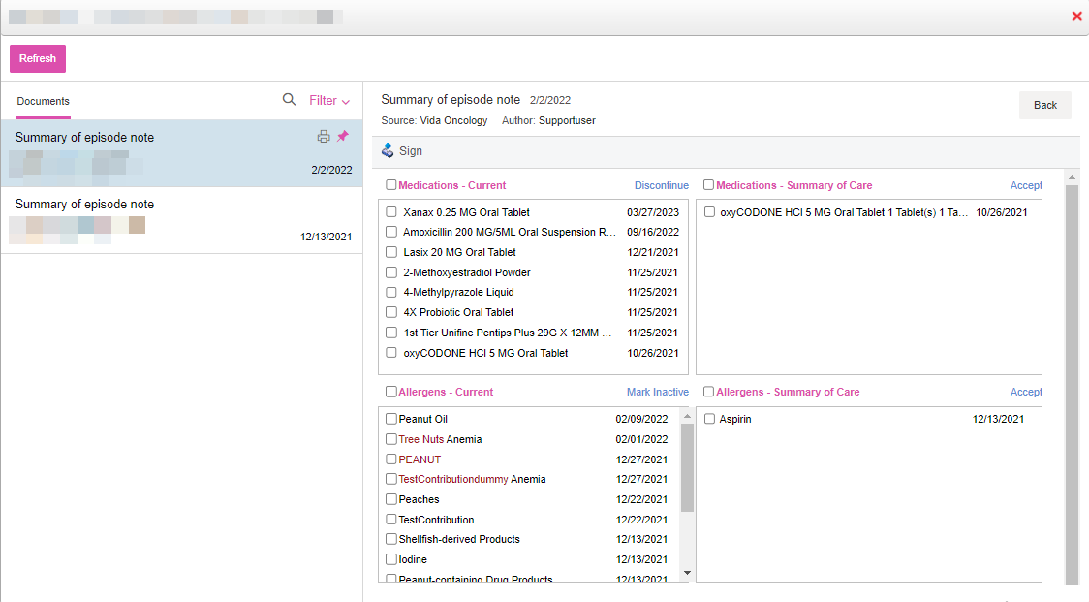
Notes:
Currently- you can easily reconcile the data in CureMD against the data in an external document for Allergies, Dx and Medications. Once you complete and save the reconciliation, you can import the data into the chart

Slide 8
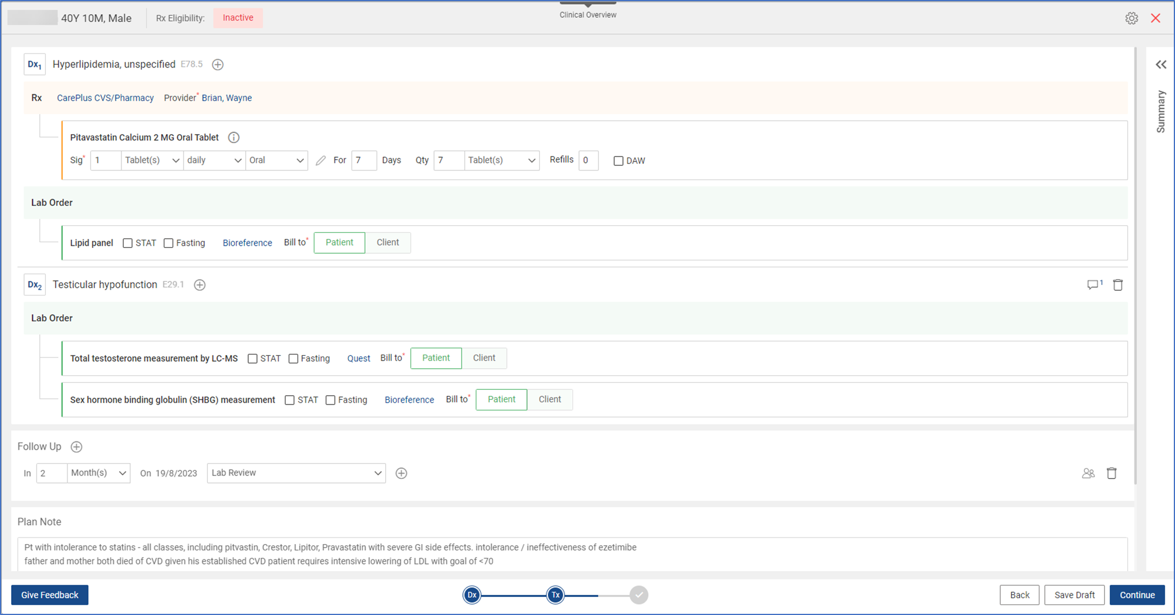
Notes:
I know some of you in the room were active participants in being Beta clients for our Treatment Plan. I want to thank you for that.
In the past, we have worked with some of the local health departments to ensure we are doing workflows that are important to you.
One such workflow that we integrated within the Tx Plan for the PH sector was the inventory Rx scanner barcode workflow for medications.

Slide 9
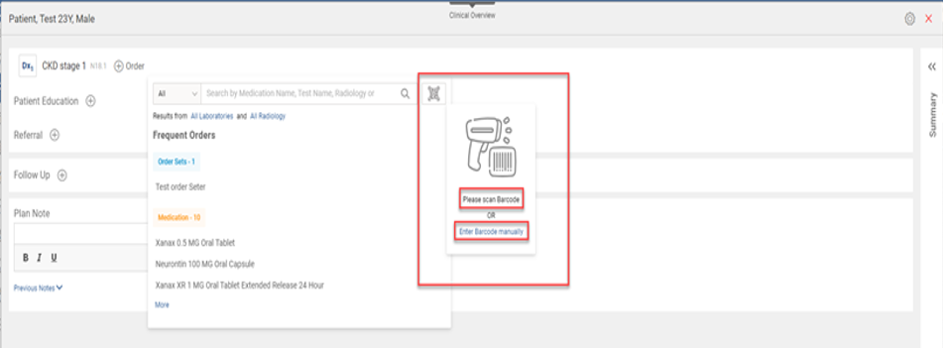
Notes:
Here’s two screen shots displaying the new Inventory Rx Scanner Workflow in the Tx Plan.
The user can scan the barcode for the medication or manually type in the barcode. Then it will display the InventoryRx information – Pharmacy name, Provider, Reserve (checkbox) on the next screen before you sign off on it.
I’ll be doing a break out session later this afternoon on the Tx Plan and the updates we are planning to make to it that will be rolled out in the first half of next year.

Slide 10
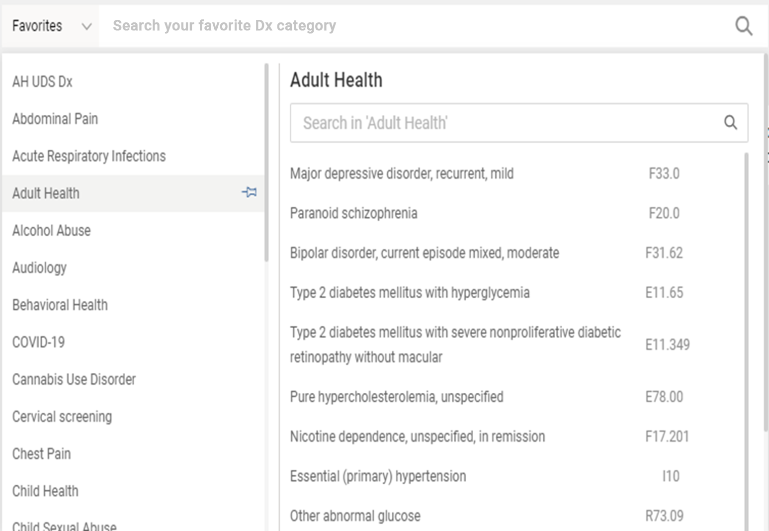
Notes:
Here’s another screen shot from the Tx Plan showing the Diagnosis search module on a real PH client.
We recently switched the technology behind the Treatment Plan to make it more provider-friendly when searching on a Diagnosis.
In the near future, we will be leveraging this same technology to suggest other problems or diagnoses that are linked to specific clinical diagnoses.
Main benefit: Reflect an accurate picture of the complexity of the patient that you are seeing and this allows Medicare to project the expected risk and future annual cost of care.
HCC’s or Hierarchical Condition Categories are sets of medical codes that are linked to specific clinical diagnoses. Since 2004, HCCs have been used by the Centers of Medicare and Medicaid Services (CMS) as part of a risk-adjustment model that identified individuals with serious acute and chronic conditions. This allows Medicare to project the expected risk and future annual cost of care. Each HCC represents diagnoses with similar clinical complexity and expected annual care costs.

Slide 11
Notes:
We did some timed studies on users to see how much time it would actually save a user doing the same ordering process from within the Tx Plan vs the Clinical Components.
Based on the data, we discovered there was a 50% reduction in charting tx plans
On average, 50 clicks saved per treatment plan.
Those are big results and could save you and your practice lots of time to do other things or even have more patients seen in a day.

Slide 12
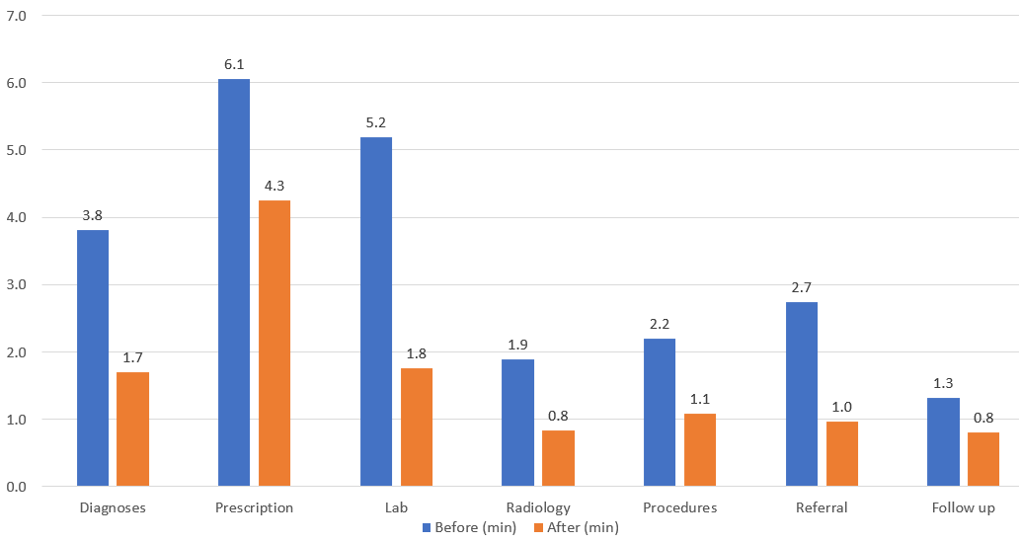
Traditional Charting versus Future Charting
Notes:
Time Comparison based on components.
Here’s the clinical component breakdown
As you can see, using the tx plan component for your Dx and Ordering can really save you and your staff a lot of time and is a much more efficient workflow.
If anyone is interested in more information about the Tx Plan, please come see me and Kristina during our breakout session later today.

Slide 13
Notes:
Next big feature I’d like to talk about is – Work Queues.
Our focus here is on making areas where there is a lot of high-volume work and multiple clicks better for you.
This will be especially important for the nurses, case managers, follow-up team registering patients – as you’re going through the Clinics and assigning prescription refills and faxes and referrals.
Now you can function off this one screen- everything you need to do for the day is configured in “Work Queues.” And it can be configured based on your role. So if you mostly handle faxes and lab results –it can be configured for you to just see those areas. If you’re on the billing side, it can be configured with cues for that.
New staff will find it easier to master the different components as well within CureMD.
If a new member joins your staff you don’t need to tell them to go to 5 different screens and monitor those areas to see if something is assigned to them
Simplifies your workflows in knowing:
What is assigned to them? How much work is pending? What needs priority attention?

Slide 14
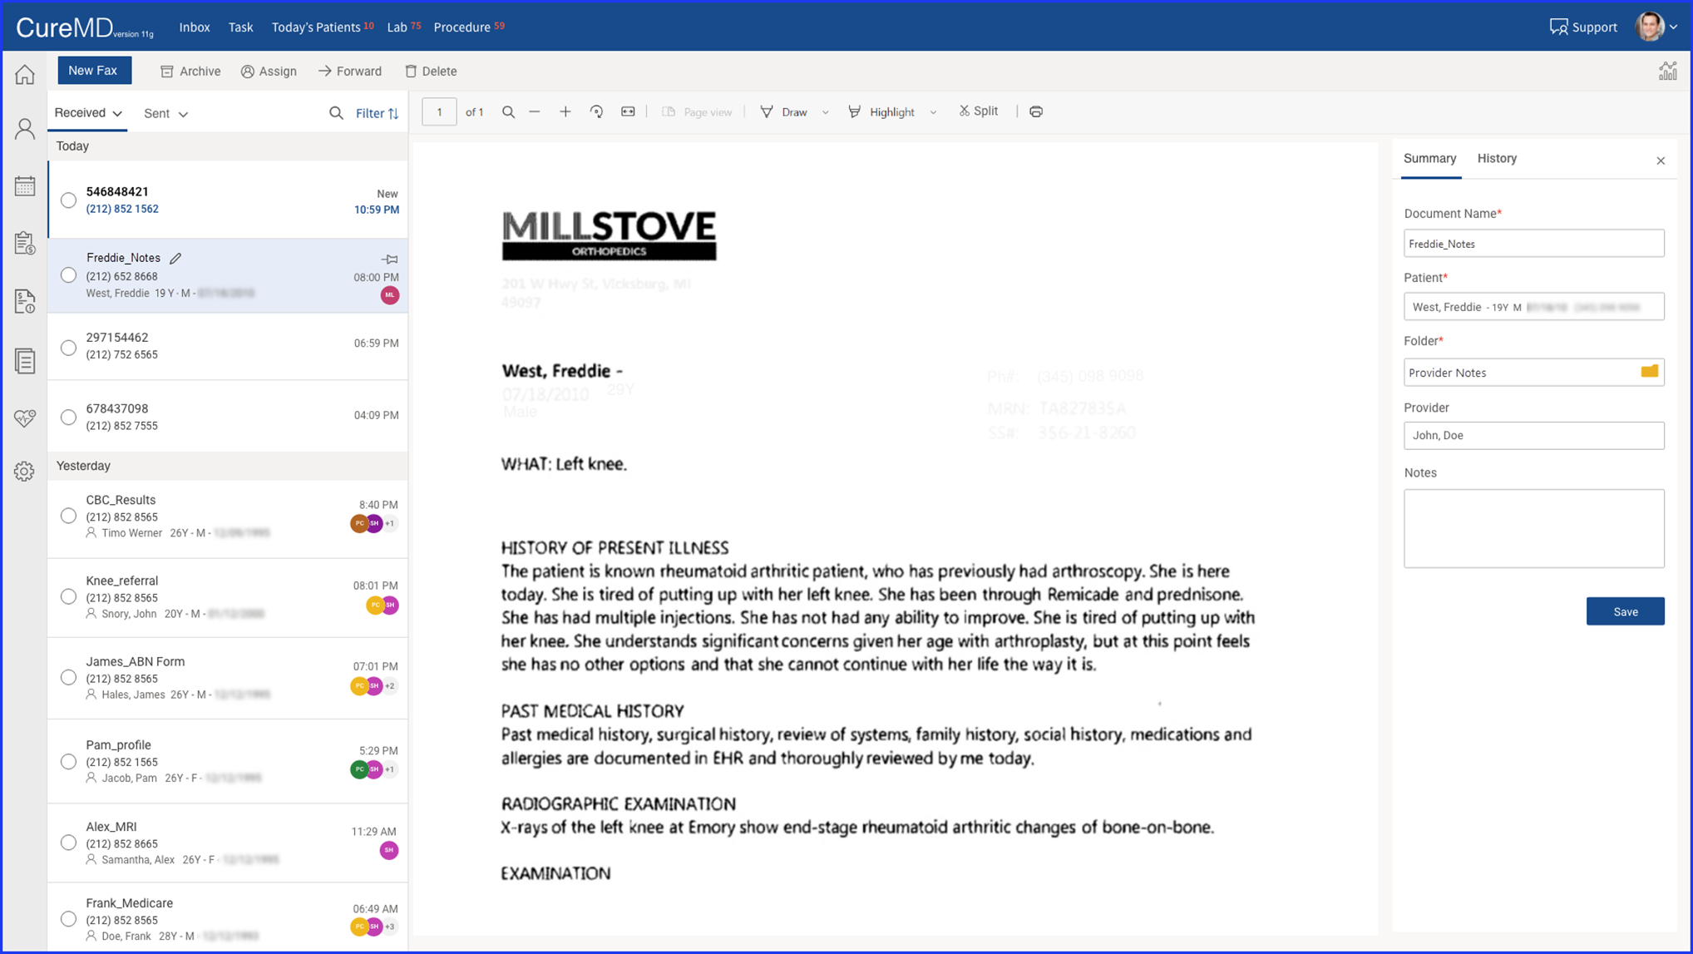
Notes:
So, we have reimagined fax management and wanted it to be similar to Referrals and lab results – easier to learn for users. Unified UI design for users decreases the burden for learning.
Big list of faxes that come in on the left hand side – you can search through them, filter them based on specific criteria, assign them or archive them
Summary of the Document selected in the panel on the right side of the screen
Process the document by assigning it, splitting it into multiple documents, filing it away
Most documents get filed in the right folder and assigned to someone for processing- we have incorporate new optical character recognition technology to identify the patient this fax is for and what kind of fax it is such as:
Lab vs spam vs Rad
It will show the level of confidence where the fax needs to go – which folder?
User looks at information and validates what is detected is correct and clicks Save.
No more dragging and dropping the faxes into the right folder.
Much more intuitive and easier to use workflow.

Slide 15
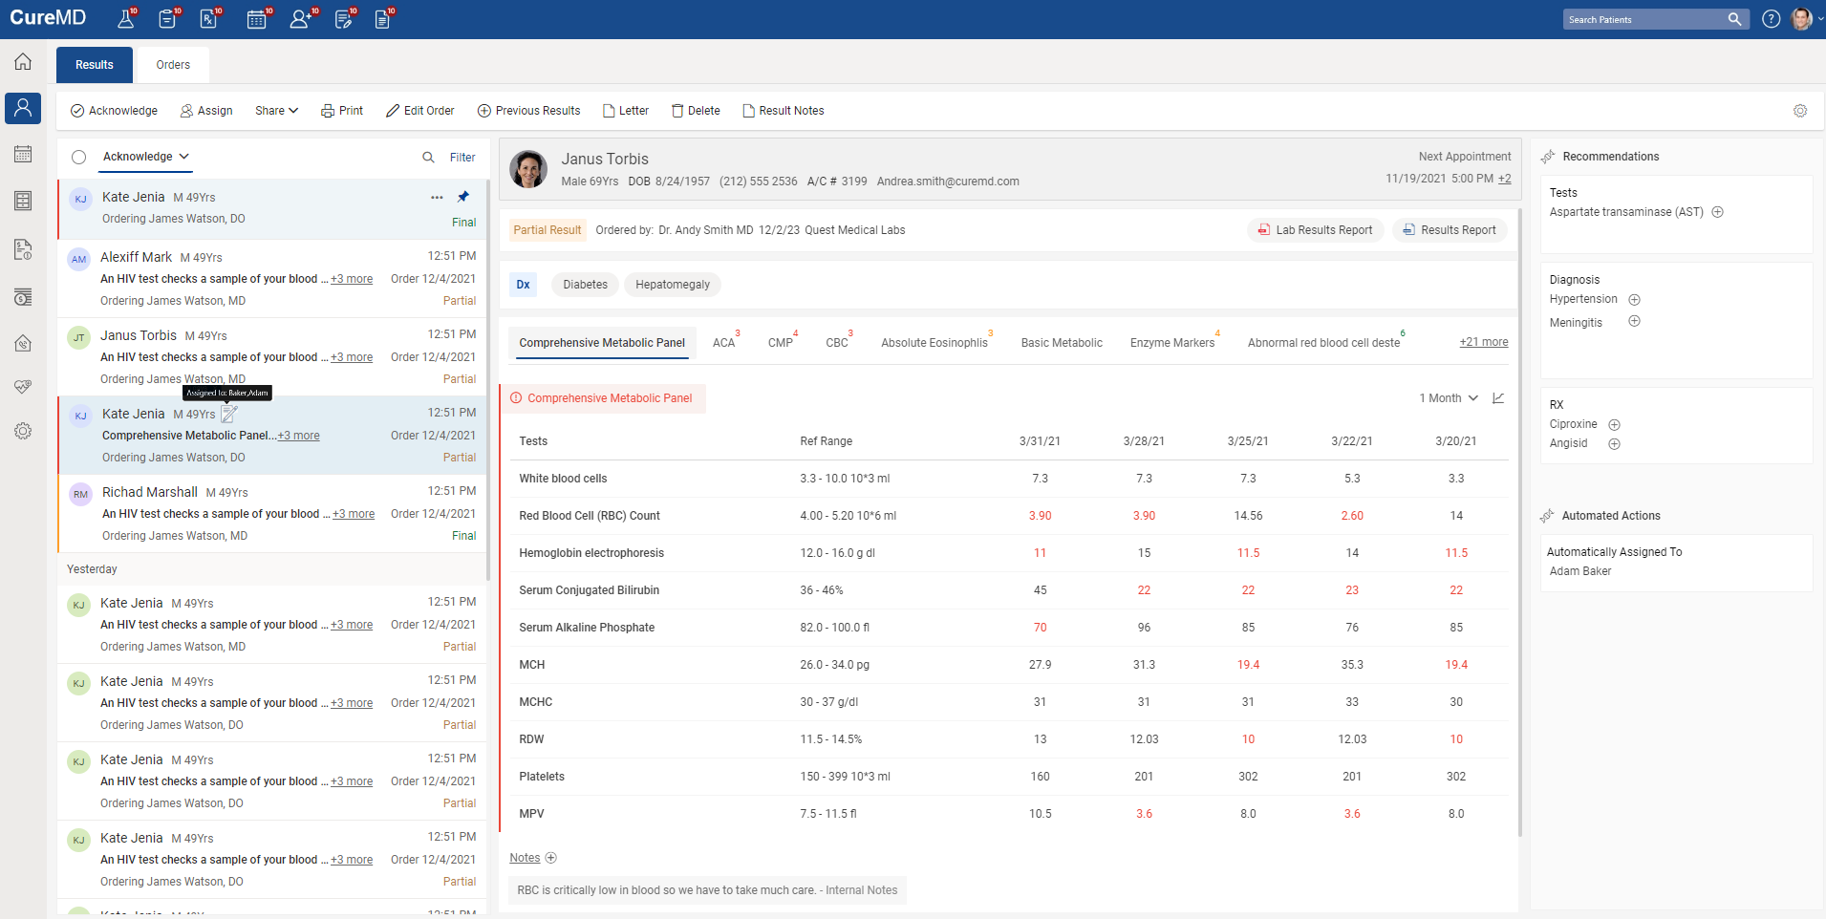
Notes:
We also revamped our Lab Results screen with this new UI design in mind:
Default view is now shown as a comparative view – showing past results by default to see progression of getting better or worse over time. We're able to provide this trending lab result view now due to our partnership with IMO.
CDSS recommendations- looking at the lab results and the provider's activity to display CDSS results for ordering more labs, dx, and prescriptions.
Automating the Assign to, Referred to and F/U fields – so if you always assign labs to a certain person in your office- the system will recognize that and assign these lab results to that person.
Same goes for Referrals and Follow-up – kick-off the process and generate a task or Referral immediately.

Slide 16
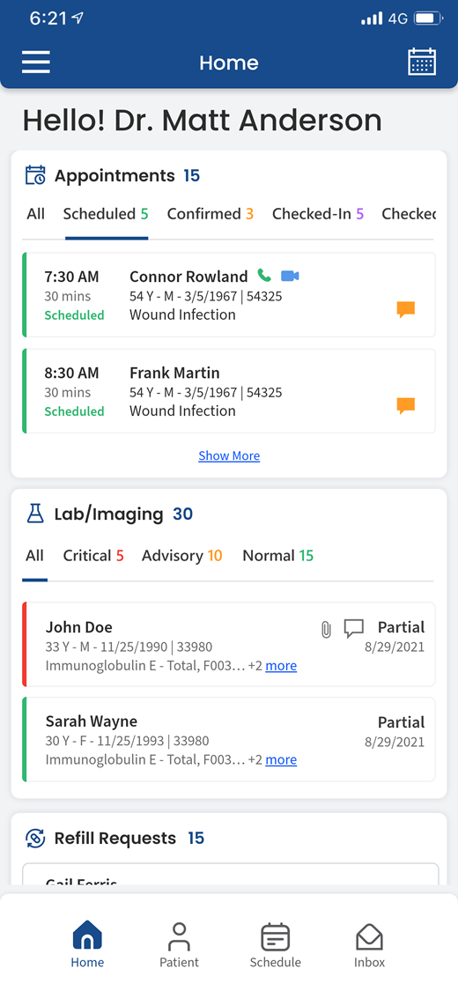
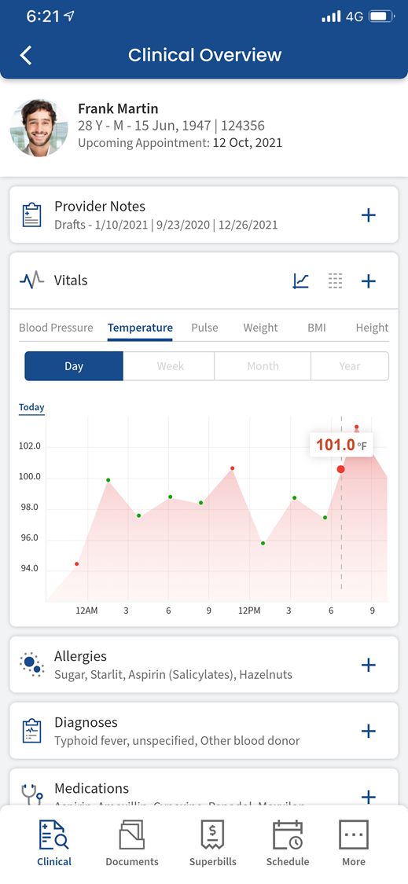
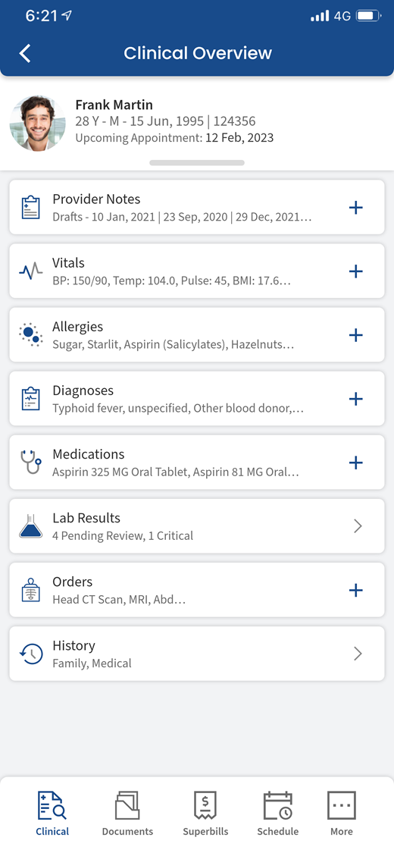
Notes:
I believe a lot of you in the room might not be using our Mobile EHR app- Avalon.
It’s a free app that you can easily download from the App store.
We’ve made a lot of updates to it over the past year and added some cool new features: personalize dashboard with access to calendars, charts and pending tasks.
iOS and Android availability
You should give it a try.

Slide 17
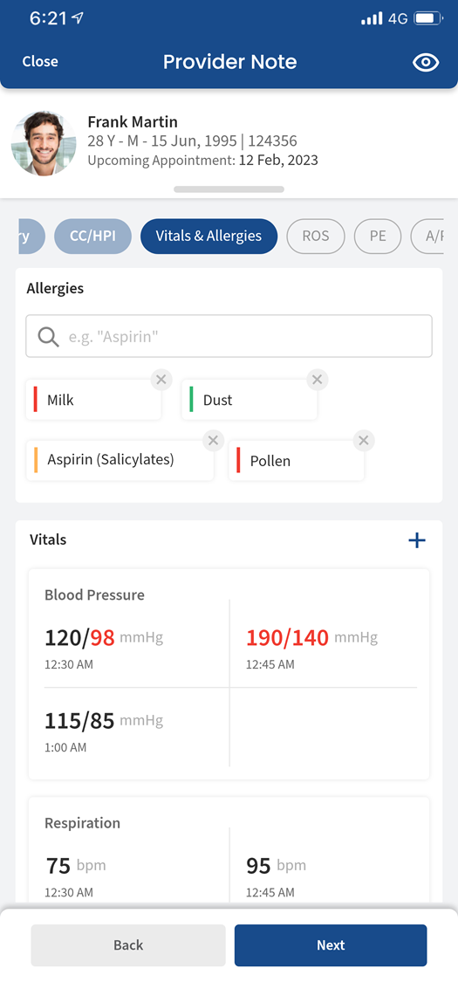
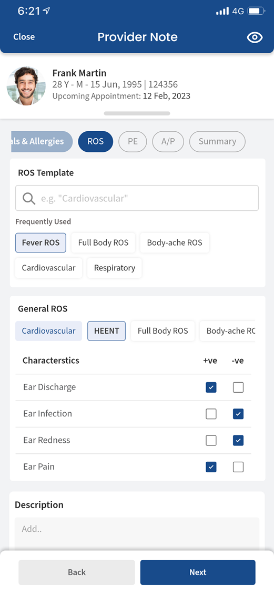
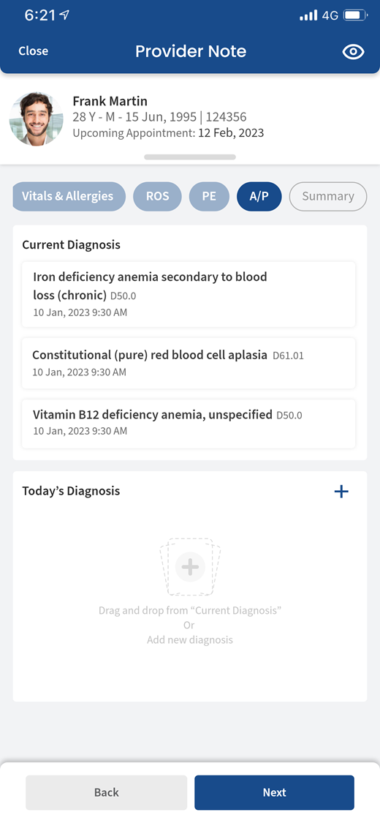
Notes:
You can now build out full-fledged provider note with editable templates
Clinical components for order review and documentations revision (on the go)
Complete system that matches our web-based version.

Slide 18
Come Join Our
Clinical Advisory Panel
Notes:
I run the CAP at CureMD.
I would love to have you sign up and participate.
You can even pick and choose which projects you are interested in doing.
I send out the Agenda prior to the call.
We meet every 3 weeks or so.
Benefit: early access to new features coming down the line for CureMD and you can make a difference.

Slide 19
Questions???

